Slide 1
Microsoft 365 & Power Platform Development – Bi-weekly call
Your host in this call: David Warner (Microsoft)
September 15th, 2022

Slide 2



v
Agenda
Latest Updates on community
PnP .NET libraries
PnP PowerShell
Independent Publisher Connectors
Latest on script samples
Latest Microsoft Teams samples
Latest on Power Platform samples
Picture time with the Together Mode!
André Lage - List formatting magic - neomorphic design for polished UX
Richard A. Wilson - Using Mockaroo Independent Publisher Connectors to automatically generate sample data

Slide 3
Opportunities to Participate in the community
Demo solution or technical pattern
Contribute on GitHub
Provide feedback
Great opportunity to get visibility for you or your company. Demo sample or explain how you extend or customize SharePoint Online with live demo in your projects. Reach out to team for volunteering.
Request a demo spot on the call
https://aka.ms/m365pnp/request/demo

Slide 4
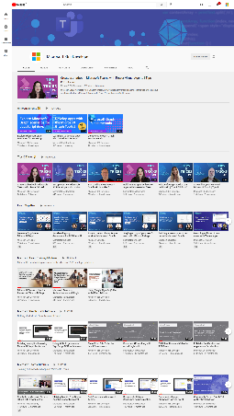
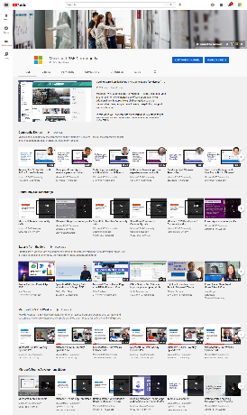
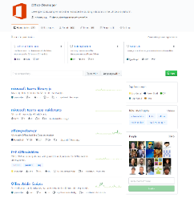
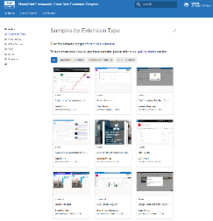
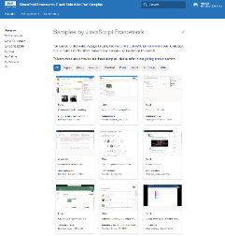
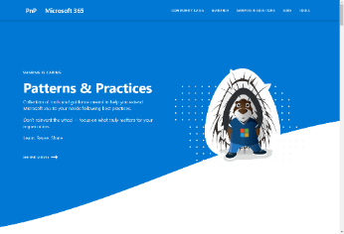
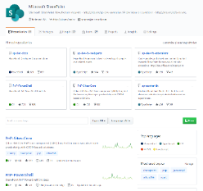
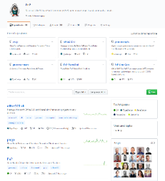
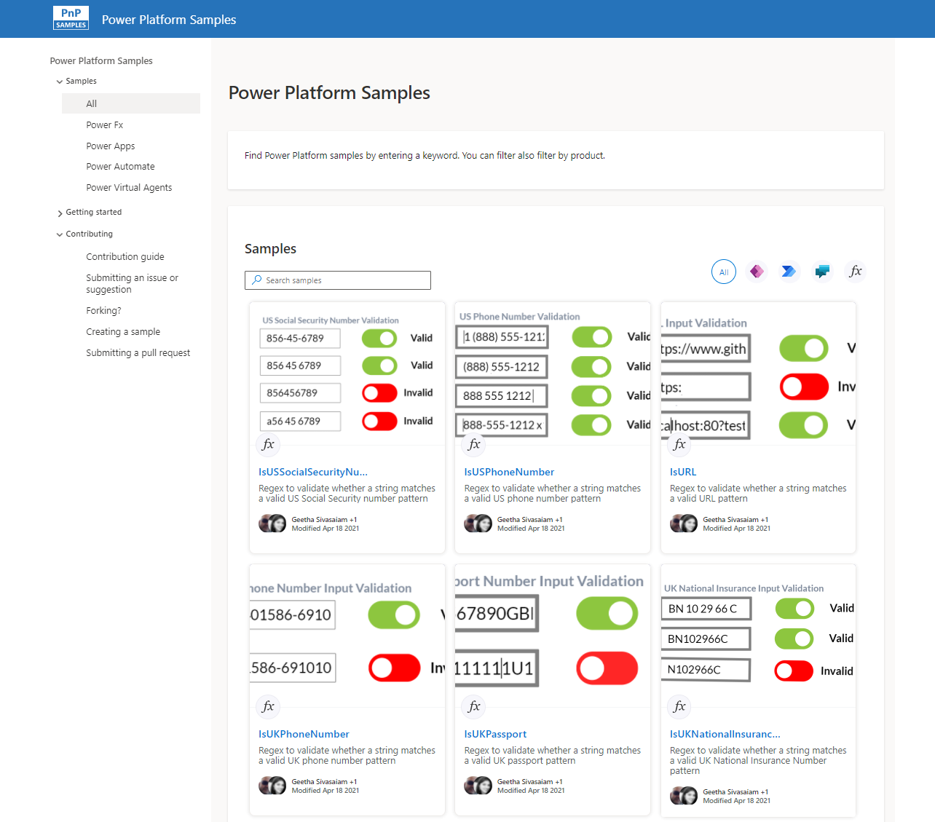
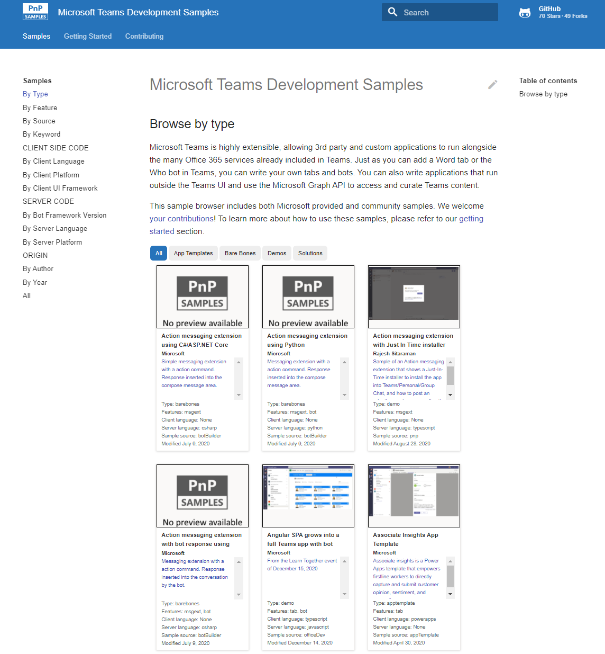
Microsoft 365 developer videos
Microsoft 365 community videos
Open-source
Sample galleries
Open-source initiatives and samples
github.com/sharepoint
github.com/pnp
github.com/officedev
github.com/microsoftgraph
aka.ms/m365/samples
aka.ms/teams-samples
aka.ms/spfx-webparts
aka.ms/powerplatform-samples
aka.ms/spfx-extensions
aka.ms/list-formatting
aka.ms/m365/community
aka.ms/m365devyoutube
aka.ms/m365pnp/videos
@Microsoft365Dev | @m365pnp

Slide 5
Microsoft 365 developer community calls
Microsoft 365 platform (weekly) https://aka.ms/m365-dev-call
Adaptive Cards https://aka.ms/adaptivecardscommunitycall
Microsoft identity platform https://aka.ms/IDDevCommunityCalendar
Office Add-ins https://aka.ms/officeaddinscommunitycall
Power Platform https://aka.ms/PowerPlatformMonthlyCall
Microsoft 365 & Power Platform Development (bi-weekly) https://aka.ms/m365-dev-sig
Viva Connections & SharePoint Framework (bi-weekly) https://aka.ms/spdev-spfx-call
Download recurrent invites from
https://aka.ms/m365/calls
Notes:
m365-dev-sig

Slide 6
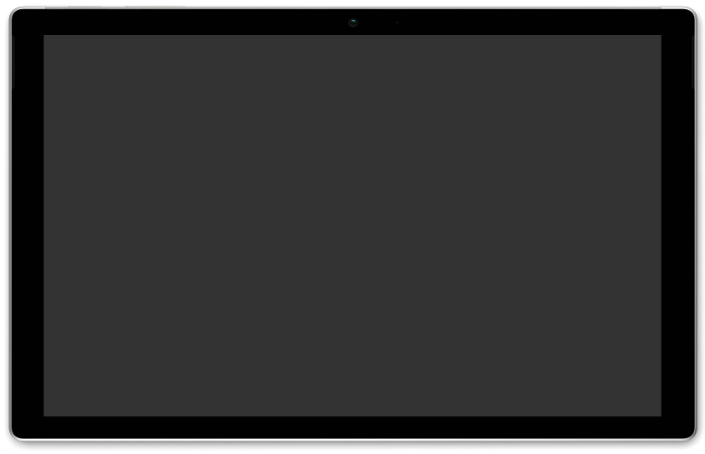






AGENDA
Latest news from Microsoft engineering on Microsoft 365 topics
Community together mode group photo
Adriana Wood, Liam Fernandez - Introduction to SharePoint Online Admin APIs on Microsoft Graph
Garry Trinder - Getting started with Teams Toolkit for Visual Studio
Microsoft 365 platform call 20th of September @ 8 AM PT
Weekly call with Microsoft presenters covering the latest Microsoft 365 platform updates
Download recurrent invite from https://aka.ms/m365-dev-call
Notes:
Dan’s slide

Slide 7
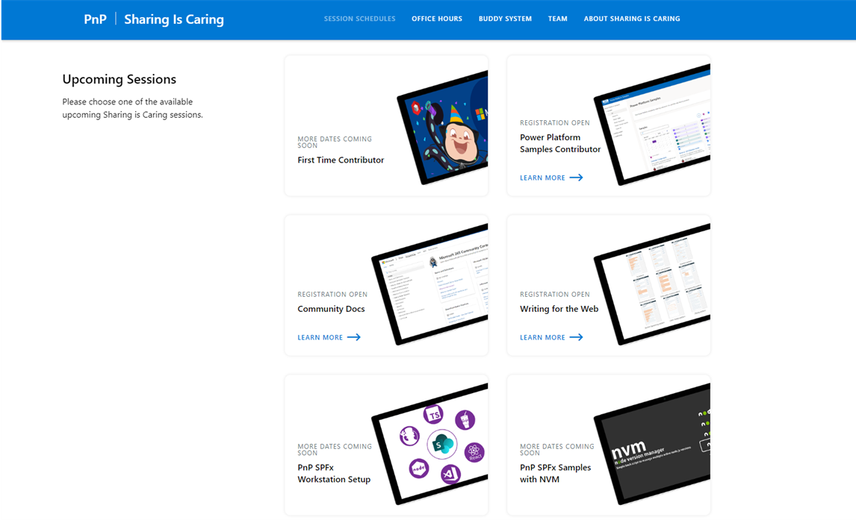
GUIDANCE
Learn how to get started in the open-source PnP community!
Upcoming Sessions:
First-time contributor
Power Platform Samples Contributor
Writing for the Web
Community Content Docs
SPFx Developer Workstation Setup
Using PnP SPFx samples w/ NVM
More than code with VS Code
First-time presenter
M365 Maturity Model Practitioners
Power Platform Samples Contributor
Live at Power Platform Conference
https://aka.ms/sharing-is-caring
Notes:
25 Total attendees, 16 attendees who attended both First-Time Contributors and Community Docs sessions.

Slide 8





COMMUNITY
PnP Recognition Program
Showcasing your contributions
Powered by Credly
More achievement levels coming soon
https://aka.ms/m365pnp-recognition
Notes:
25 Total attendees, 16 attendees who attended both First-Time Contributors and Community Docs sessions.

Slide 9
PnP .NET libraries A set of libraries that helps Microsoft 365 .NET developers to be more productive when working with SharePoint and Teams

Slide 10
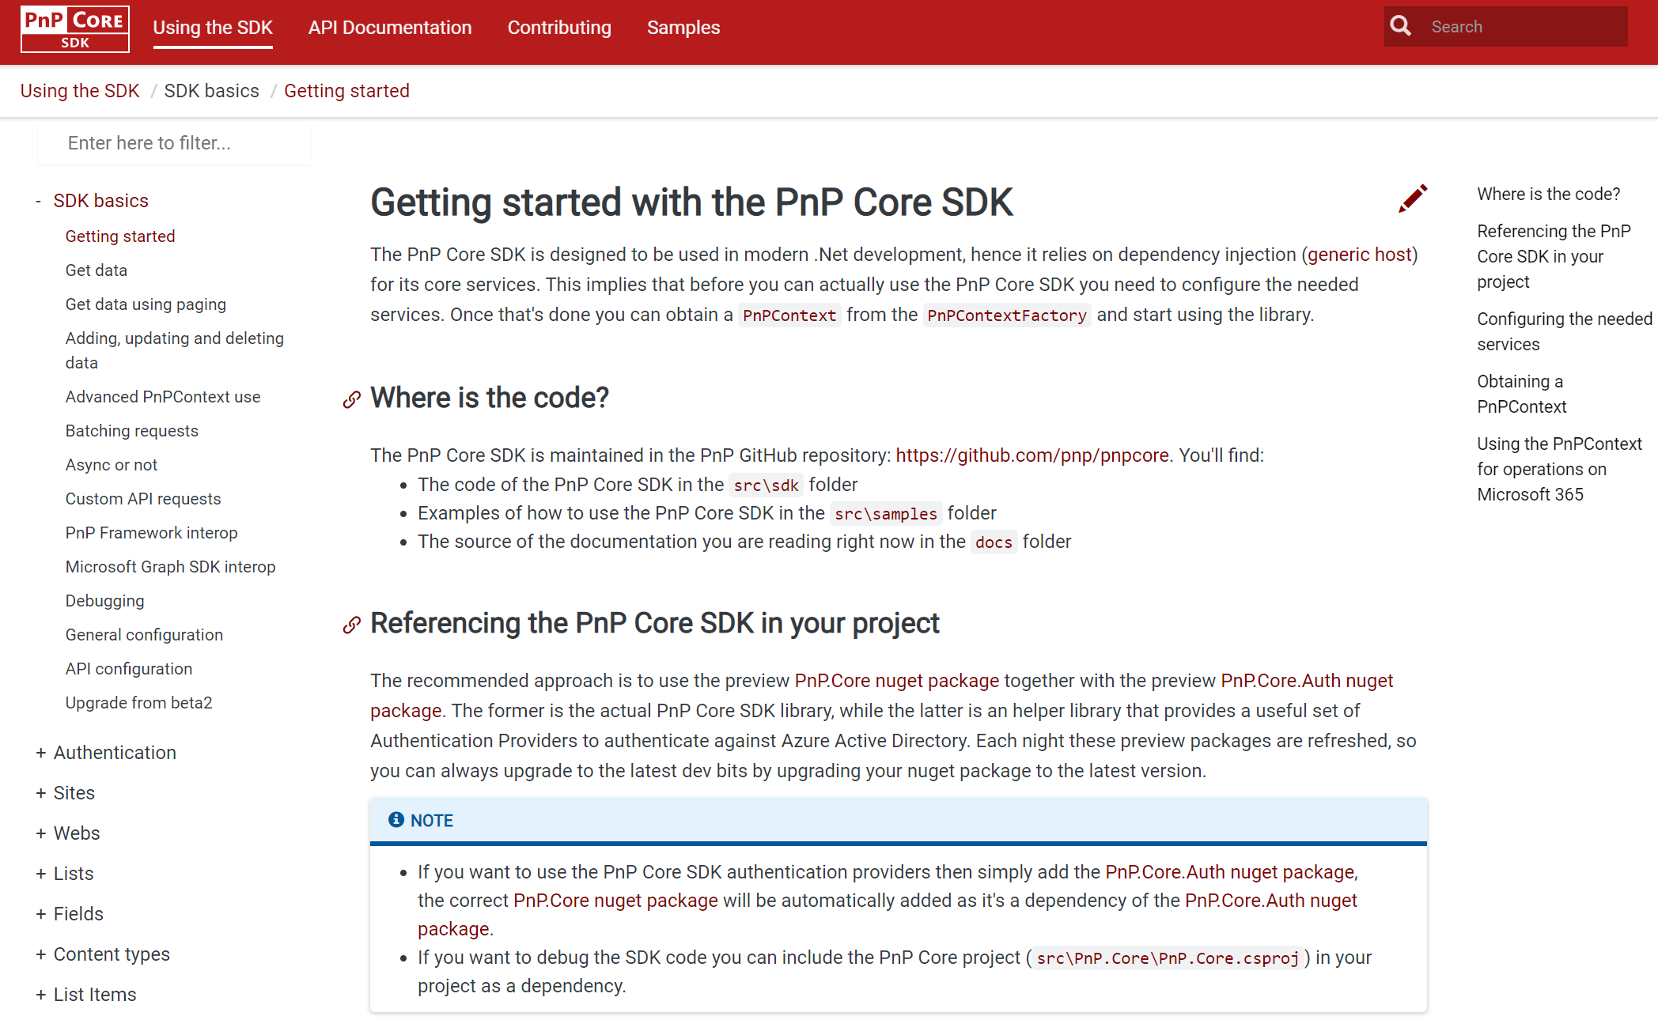
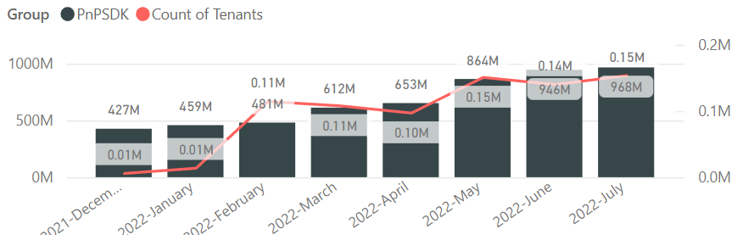
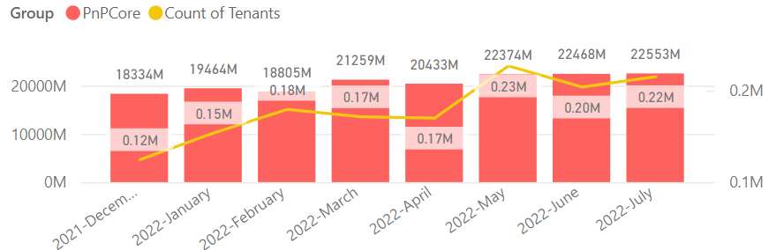

PnP .NET libraries
PnP Framework
PnP Core SDK
>220.000
Tenants in a month!
>741,000 downloads!
Prepping 1.11.0:
Merge pending PRs
General fixes and improvements: 👍 Ronald Booden, Daniel Pastoor, Ole Rühaak and friendbool
New PnP Provisioning Schema v. 202209 is upcoming
Feedback welcome on GitHub repo (https://github.com/pnp/PnP-Provisioning-Schema)
>965,000 downloads!
Prepping for 1.8.0:
Integrate license information in Nuget packages: Landon Petzoldt 👍💪🚀
Support for column defaults, re-indexing of a list or web and test mocking (via Moq): Bert Jansen 🚀
Fixes and improvements: Martin Lingstuyl, Llewellyn Roos, Bert Jansen 👍
Working on it
What key scenarios are still missing?
https://github.com/pnp/pnpcore/blob/dev/src/sdk/CHANGELOG.md
Roadmap
nuget.org/profiles/pnp
nuget.org/profiles/pnp
aka.ms/pnp/framework
aka.ms/pnp/coresdk

Slide 11
PnP PowerShell Open-source cmdlets which provide you an easy way to manage your SharePoint and Teams environment.

Slide 12
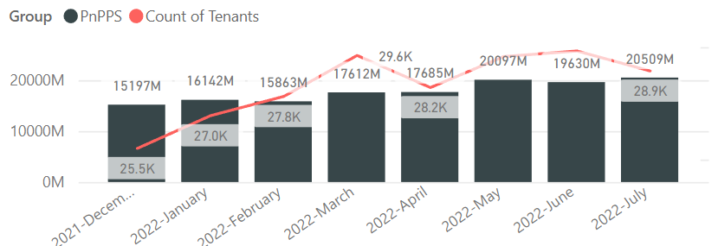

PnP PowerShell
Cross Platform PnP PowerShell
~29.000 tenants!
V1.11.0 released Many updates, improvements and fixes!
2.9 million downloads!
100 million cmdlets executed per day!!
Docs shifted, no more docs.microsoft.com
Documentation, Articles and tips available at : https://pnp.github.io/powershell
Thinking of dropping support for PS 5, any strong objections ???
PnP PS runs in PS 5, PS 7, Azure CloudShell, Azure Functions, Azure Runbooks & Raspberry Pi
New Stuff
Nightly builds continue
HTTPS prefix is not required for Connect-PnPOnline
Added IsLoopEnabled for Get\Set-PnPTenant cmdlets
Support for creating Shared Teams channels in Add-PnPTeamsChannel
Improved Add-PnPField, Get-PnPAuthenticationRealm and Get-PnPStorageEntity cmdlets
What next, .NET 6.0 support ? Would love to hear your thoughts !
Release: https://github.com/pnp/powershell/releases/tag/v1.11.0
PnP PowerShell extension - Visual Studio Marketplace
Working on it
github.com/pnp/powershell
www.powershellgallery.com
PnP.PowerShell
https://github.com/pnp/powershell/blob/dev/CHANGELOG.md

Slide 13
yo teams Open-source Yeoman generator for Microsoft Teams development

Slide 14
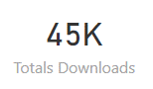
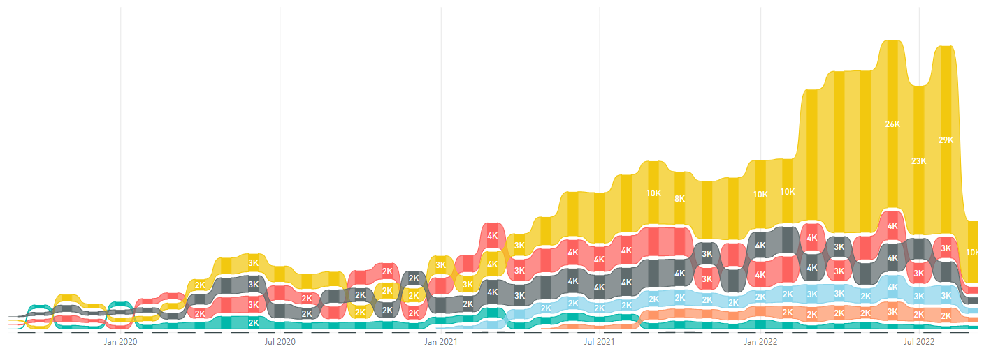
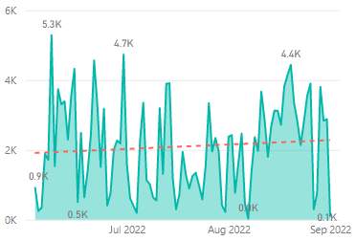
yo teams
https://aka.ms/yoteams
generator-teams – The Teams apps generator
Package Downloads
Help wanted 🤝
📃 Docs published at https://pnp.github.io/generator-teams/
🚀 Latest release: 4.0.1 [2022-06-28]
Fixed an issue with tab configuration
📅 Top of mind:
⁉️ VS Code extension for yo teams ⁉️
Option to add SSO for teams apps during scaffolding
Option to integrate Microsoft Graph Toolkit
Update UX of scaffolded tabs
Add support for meeting extensions
More Docs & Tutorials
yoteams-build-core
yoteams-deploy
Daily build events
🚀 Latest release: 1.7.0 [2022-06-23]
Added support for Schema 1.13. Requires Node 14 or later Dependency package updates Fixed issue with telemetry timeout at the end of scaffolding
🔮 Preview: n/a 📅 Roadmap: ???
🚀 Latest release: 1.2.0 [2022-06-23]
Requires Node 14 or later Dependency package updates
🔮 Preview: : n/a
📅 Roadmap:
???

Slide 15
Microsoft Graph Toolkit Web Components powered by Microsoft Graph

Slide 16

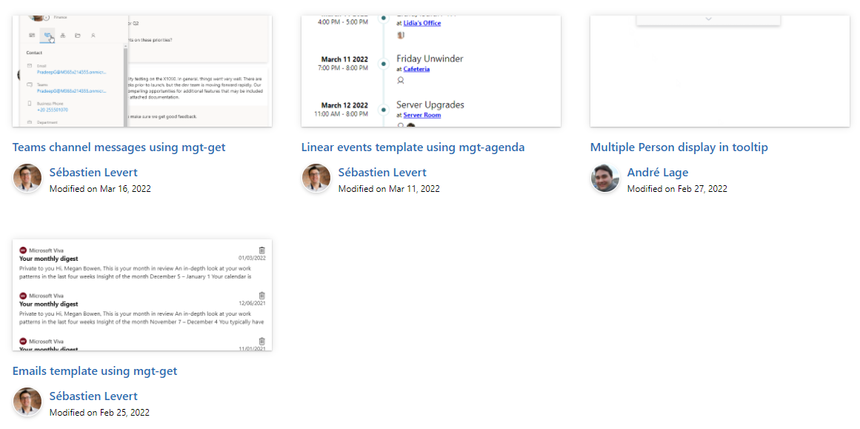

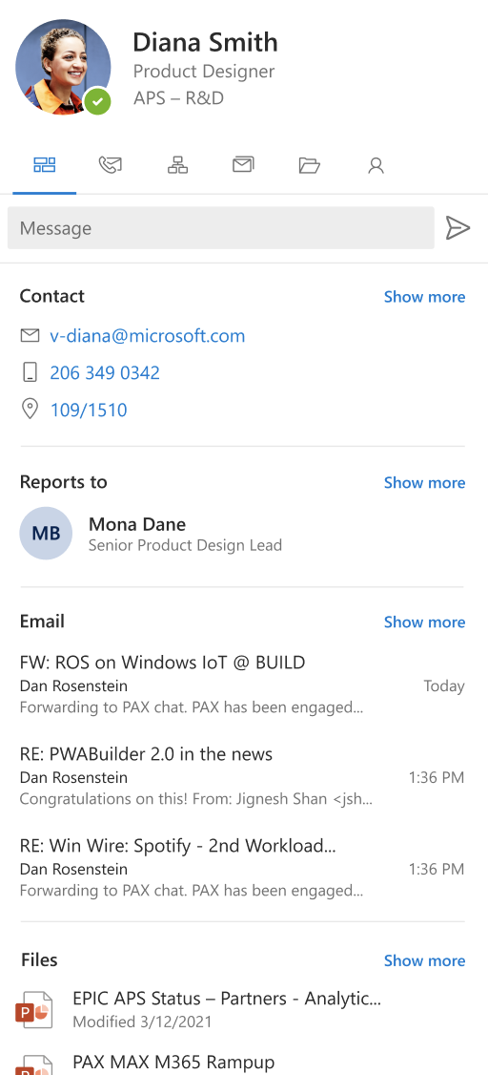
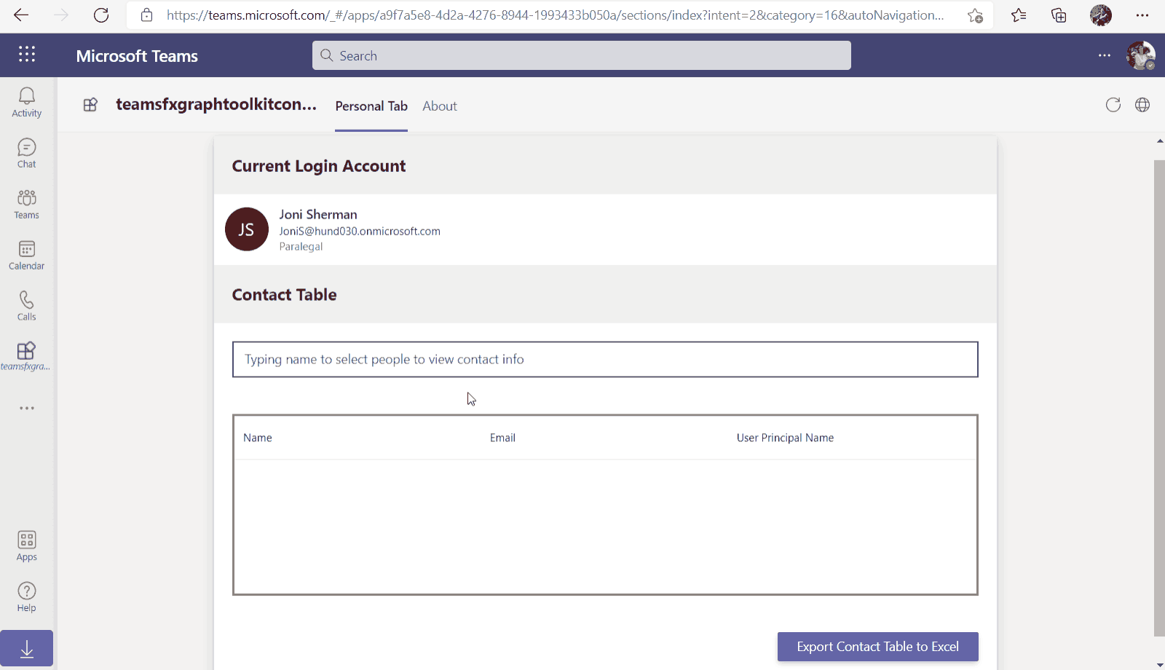
Microsoft Graph Toolkit
👀 More information: aka.ms/mgt
What’s new 🎉
V2.6.0 is our latest release! Update your packages! https://aka.ms/mgt/v2.6.0
Accessibility updates
Support for SPFx 1.15
Documentation on TeamsFx
Updates mgt-people-picker
Thanks @wuxiaojun514 for your contributions 🎉
The MGT samples repository is live! Keep your contributions coming! https://aka.ms/mgt/samples
What's next? 💻
Aligning all Toolkit components to Fluent UI Web Components
More generic components and theming capabilities
We need your help ❤️
🐞 Help us fix bugs
🆕 Help us build/improve features
help-wanted & good-first-issue -> https://aka.ms/mgt/issues

Slide 17

Independent Publisher Connectors
What’s new
55 Awesome Independent Publishers!
170 Independent Publisher connectors!
Updates: 1
Tomasz Poszytek- VIES by European Commission
New connectors: 4
Miyake Hideo- Connpass
Tomasz Poszytek- Working days
Troy Taylor- HTTP Garden
Shreyan Fernandes (Welcome!) - Proposal for NFT Mania
We need your help
Become an Independent Publisher by building one of these connectors: Top Connector Asks · microsoft/PowerPlatformConnectors Wiki (github.com)
OR
By adding more functionality to one of the existing Independent Publisher connectors on the Power Platform
Welcome Jocelyn, the new leader of the Independent Publisher & Verified Publisher program!!!!! ☺

Slide 18
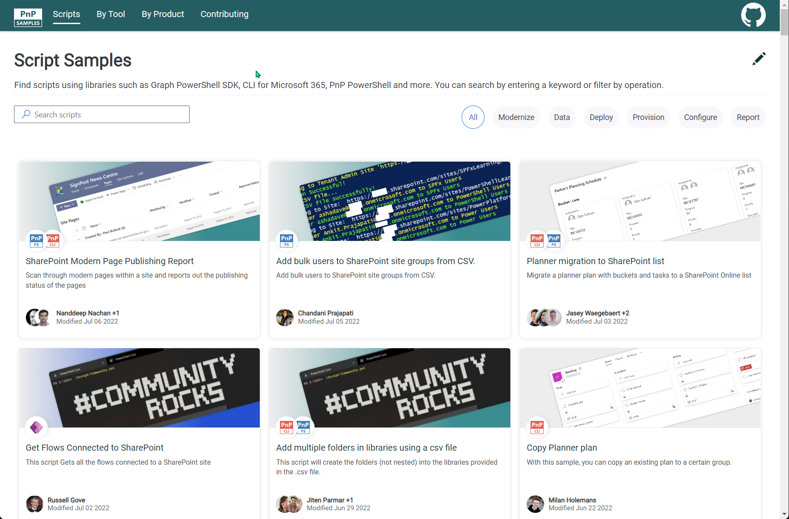


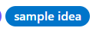
SCRIPT SAMPLES
One centralized location for all scripts for helping your day-to-day life. Contribution's welcome!
Site now has 165 scenarios and 250 scripts, using Microsoft Graph, CLI for Microsoft 365, PnP PowerShell, SPO Management Shell tooling and more…😁 AND samples integrated into "Unified" Solution Gallery
Awesome 🤩😃🎉👏 Samples Include :
New scenario using Graph PowerShell SDK
Microsoft Graph PowerShell SDK for Common Operations by Nik Charlebois
New Scenario using PnP PowerShell
SPO Recover Deleted Meeting Recordings by Jason Baxter
Did you know you can filter by cmdlet? Just type it in the search and see the results.
Want to contribute:
We have contribution guidance to get going using the “contributing” link on the site navigation or reach out to Paul Bullock on Twitter (@pkbullock), open to DMs, if you need help to get going.
Want to get to the repo behind the site quickly – click on the Octocat in the top-right of the site:
Thank you for your samples and contributions – your awesome and happy autumn!
Ramin Ahmadi
Martin Lingstuyl
Reshmee Auckloo
Todd Klindt
Leon Armston
Paul Matthews
Lewis Baybutt
Ramin Ahmadi
Arash Aghajani
Michaël Maillot
👏
aka.ms/script-samples
good first issue
We have good firsin the GitHub Repo with sample ideas of scripts that you could contribute to ☺ https://github.com/pnp/script-samples

Slide 19



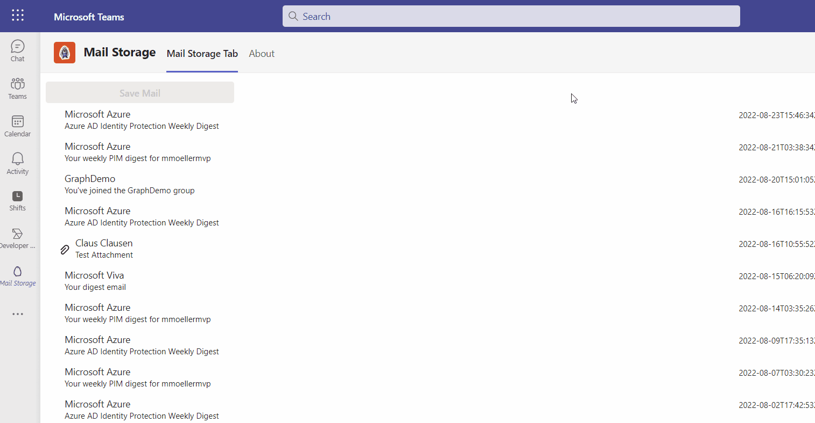





Microsoft Teams Samples
SAMPLES WANTED!
Coming soon!
Volunteers Needed!
New sample from Markus Moeller
Works in Teams and Outlook
Store emails in OneDrive
Working to include TeamsFx samples in the browser: http://aka.ms/TeamsFx-Samples
Check out all the samples! https://aka.ms/m365-samples
Teams samples w/filtering https://aka.ms/teams-samples
Please check out all the samples! https://aka.ms/m365-samples
https://aka.ms/teams-samples
Notes:
Wajeed Shaikh – Teams PM

Slide 20

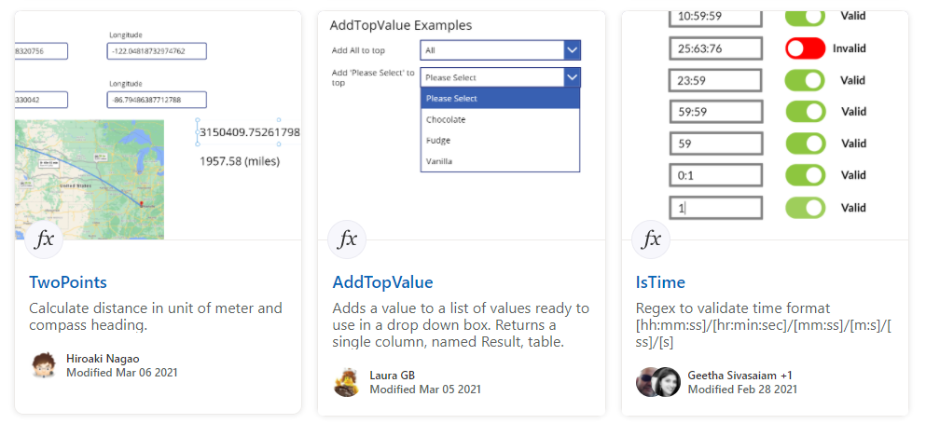
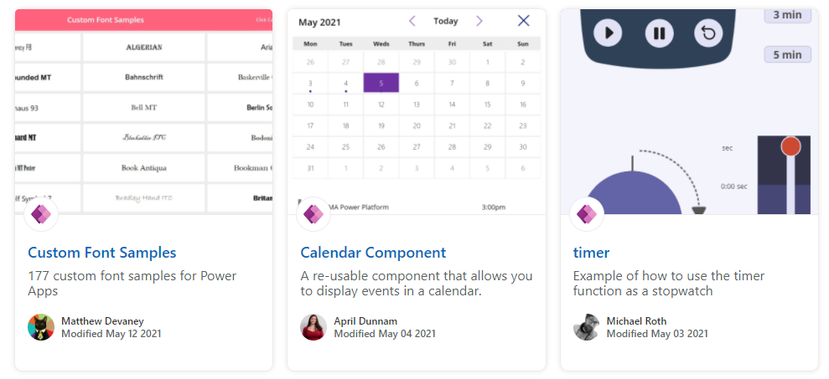
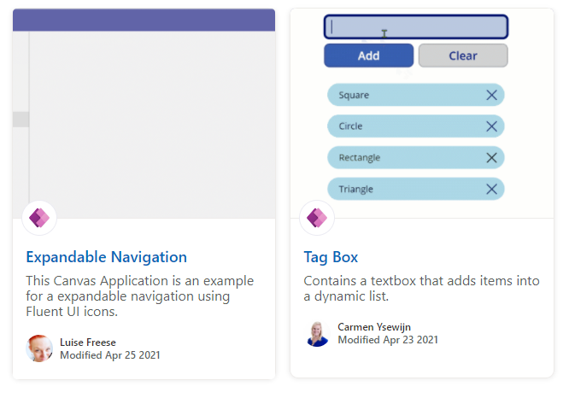
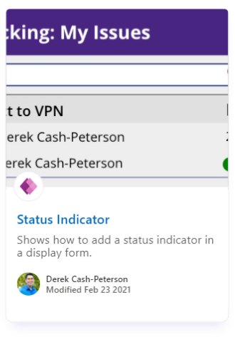
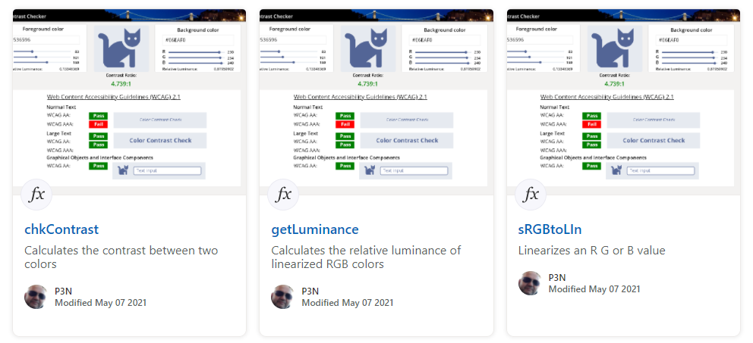
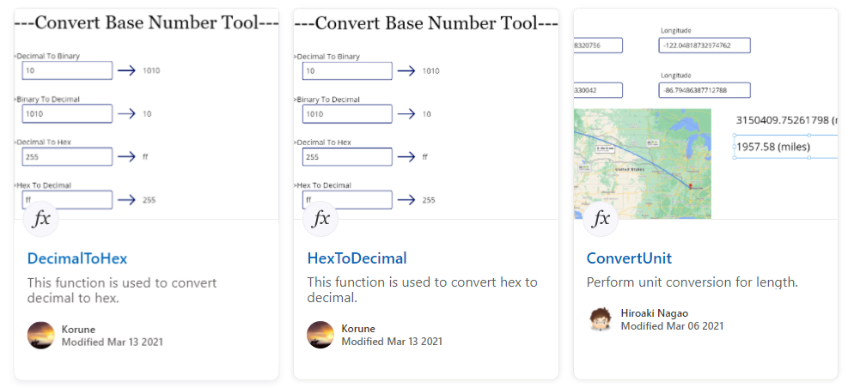
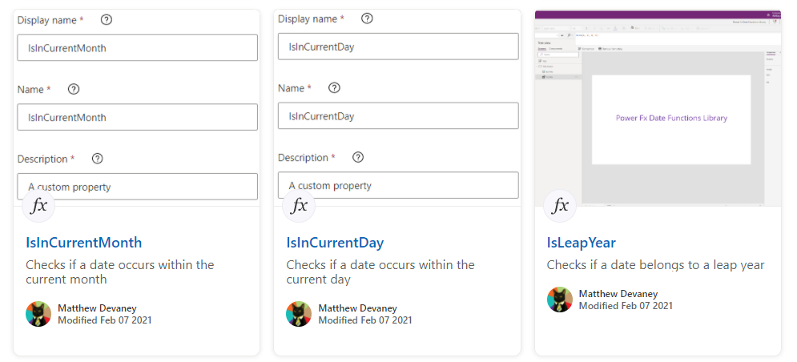
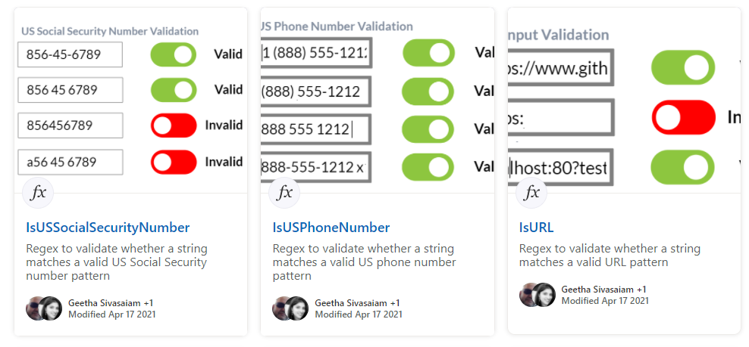
Power Platform Samples
aka.ms/powerplatform-samples ​
Power Apps templates​
Power Apps components​
Power Apps connectors​
Power Fx Custom Functions
Power Automate flow templates​​
PowerBI​​
Power Virtual Agents​​
Join the Power Platform Contributors
Sharing is Caring Session
LIVE @ Power Platform Conference

Slide 21
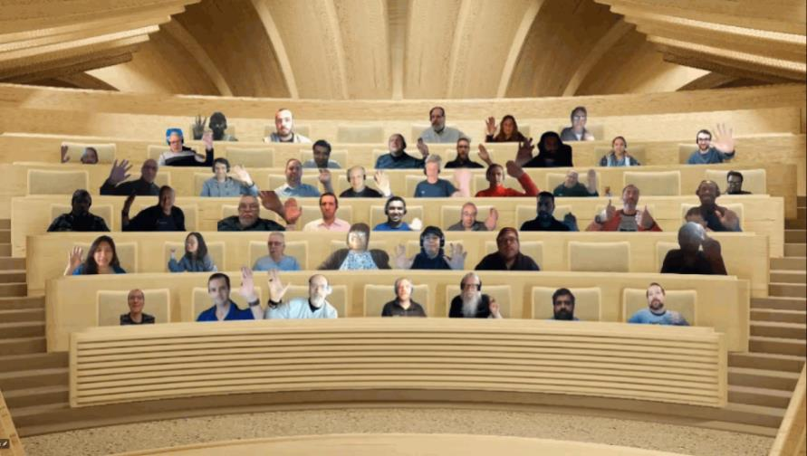

Optional picture time!
Video on and we’ll grab a Together Mode pic with those who are willing to do this.
We are together on this as a community!
By enabling your camera for the picture, you’ll give us the permission to share your picture in social media.

Slide 22
DEMO
List formatting magic - neomorphic design – André Lage
Independent Publisher Connectors - Mockaroo Demo – Richard A. Wilson

Slide 23

Q&A

Slide 24
Thank you
Recording will be available in 24 hours on
Microsoft 365 Community (PnP) YouTube channel
https://aka.ms/m365/videos
(subscribe today)
Follow us on Twitter
@Microsoft365Dev | @M365PnP
Next M365 General Dev call: September 29th at 07:00am PT
Next Viva Connections & SharePoint Framework call: September 22nd at 07:00am PT
See all other community calls from https://aka.ms/m365/calls

Slide 25



Slide 26
Thank you

